Slide 1
Solving Closed Source Issues Through Open Source
For Selfish Reasons
Vlad Drumea
Principal Analysis & Development DBA Wolters Kluwer
2024

Slide 2




Vlad Drumea
Microsoft SQL Server DBA
I specialize in query performance optimization, database security, and automation. I’ve been working with Microsoft SQL Server since back when version 2008R2 was “new”.
Microsoft Certified
Solutions Expert (MCSE): Data Platform
Solutions Expert (MCSE): Data Management and Analytics - Charter Member
Principal Analysis & Development DBA, Wolters Kluwer
Community contributor
I actively contribute to the Microsoft Data Platform community through various open source projects and through my blog.
/vladdrumea
@VladDBA
/VladDBA
https://vladdba.com

Slide 3
Agenda
Glossary
Two pain points for DBAs
Dealing with the first pain point
Great for DBAs, but…
Tackling the “but”
End result - An all-in-one diagnostics tool
Unexpected bonus
The selfish part – take 2
Future plans
Conclusion
Q&A

Slide 4
Glossary
Term | Meaning
SQL Server | Microsoft’s Relational Database Management System (RDBMS)
SQL | Structured Query Language – the domain-specific declarative language used for interacting with and managing of data stored in RDBMS
T-SQL | Microsoft’s implementation of SQL
Execution plan | A detailed roadmap containing the steps that the database engine takes to perform the data manipulation required by the query
Deadlock | Occurs when two or more requests are stuck, each waiting for the other to release a resource (a row or table) that they need to proceed, causing both to be blocked indefinitely*. *until SQL Server forcefully terminates one of the sessions.

Slide 5
Two pain points for DBAs
Selfish part – take 1
Some shops don't do SQL Server monitoring well (or at all). And, even if they do, some monitoring tools can freeze up during ongoing performance issues.
Diagnostics data isn’t very portable and can be challenging to present in a way that's easily understandable to other teams.

Slide 6
Dealing with the first pain point
Open Source to the rescue!
Brent Ozar’s SQL Server First Responder Kit - /BrentOzarULTD/SQL-Server-First-Responder-Kit
A top-tier open source toolkit for SQL Server diagnostics, covering essential DBA/developer needs to pinpoint performance issues. Licensed under MIT.
Deadlocks
Session activity
Instance health check
Index issues and usage
Waits – historical & current
Resource intensive queries & their execution plans

Slide 7
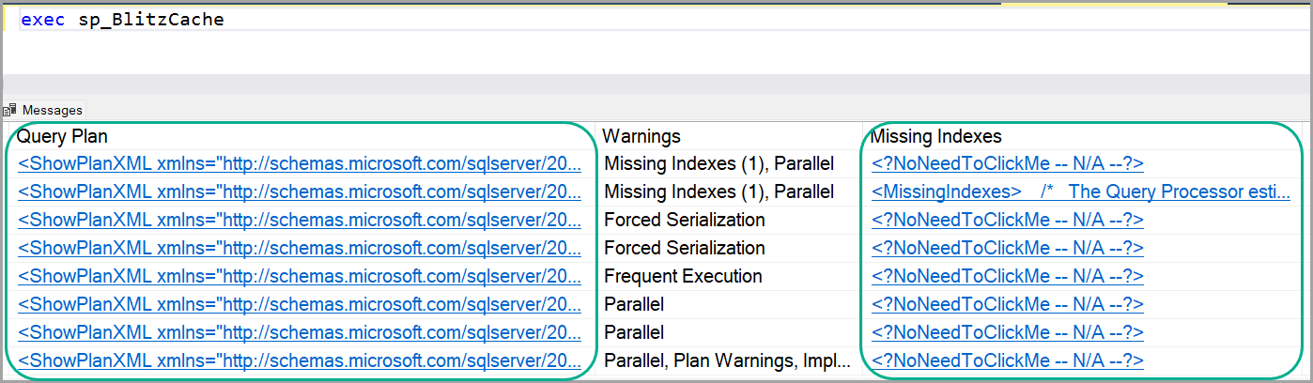
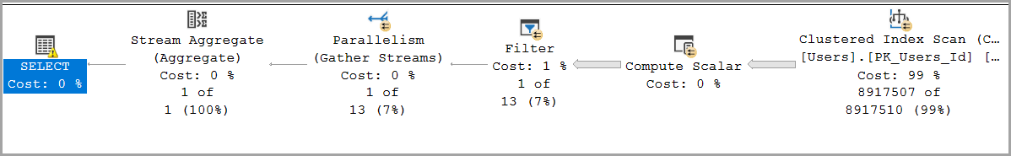
Great for DBAs, but
You’re still stuck with two issues - 1
Portability
The results look great in SSMS, but are difficult to put into an Excel spreadsheet.
Even with parameters like @ExportToExcel =1, we end up skipping execution plans and deadlock graphs due the columns being XML

Slide 8
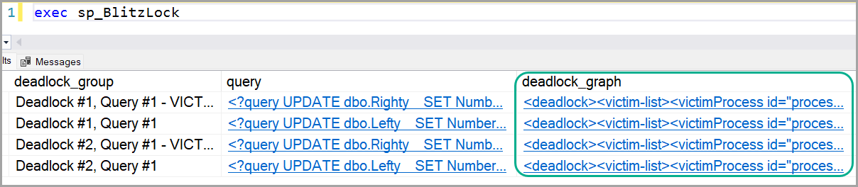
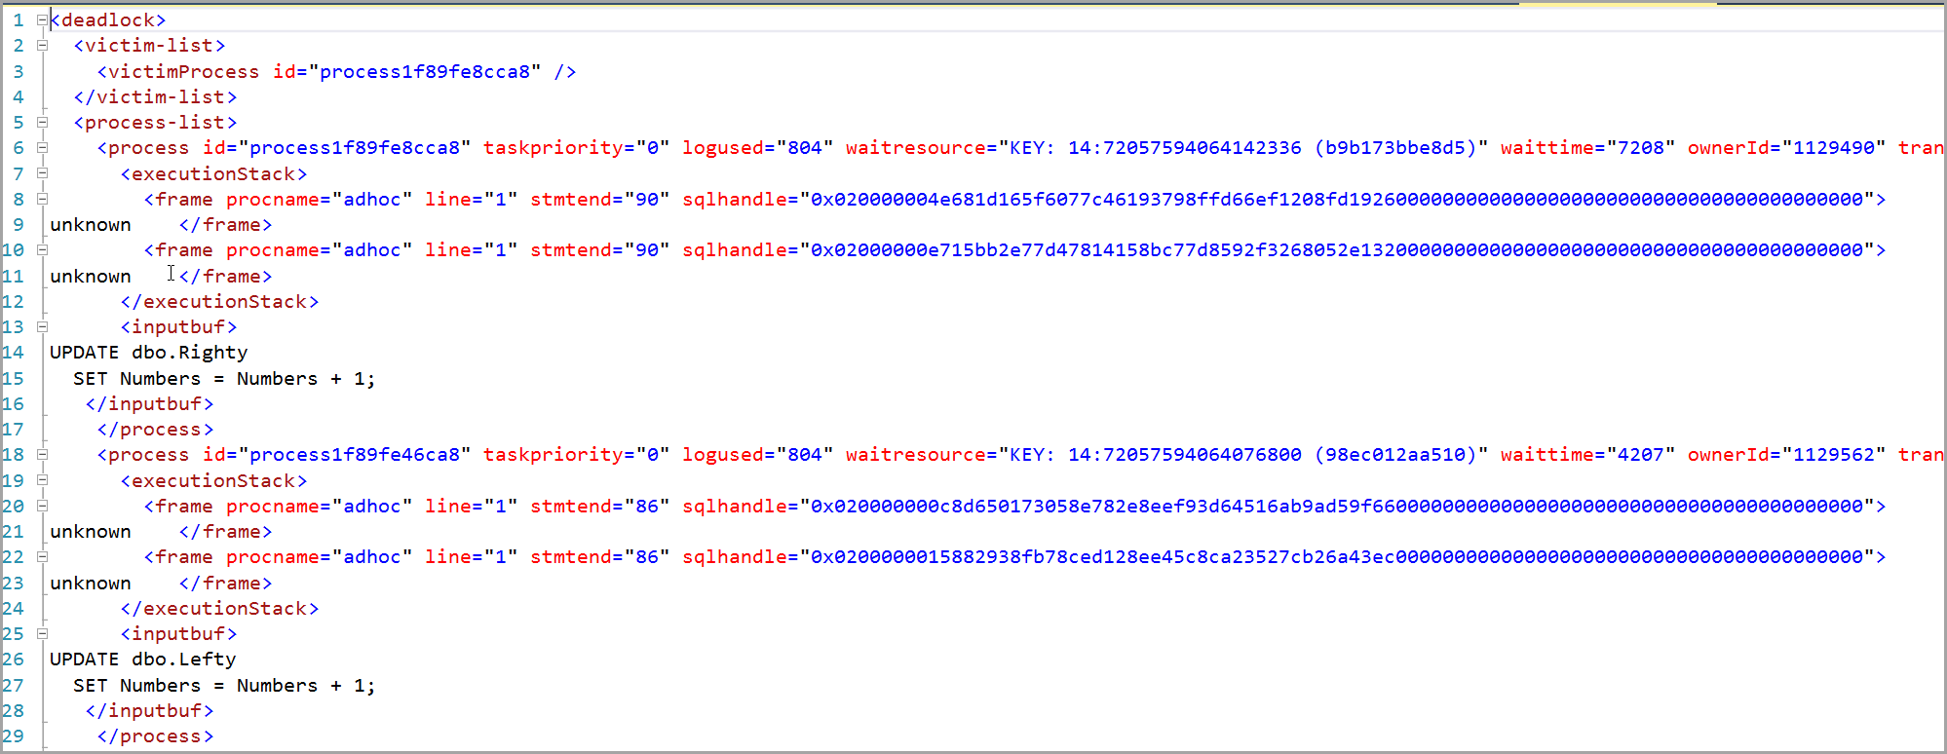
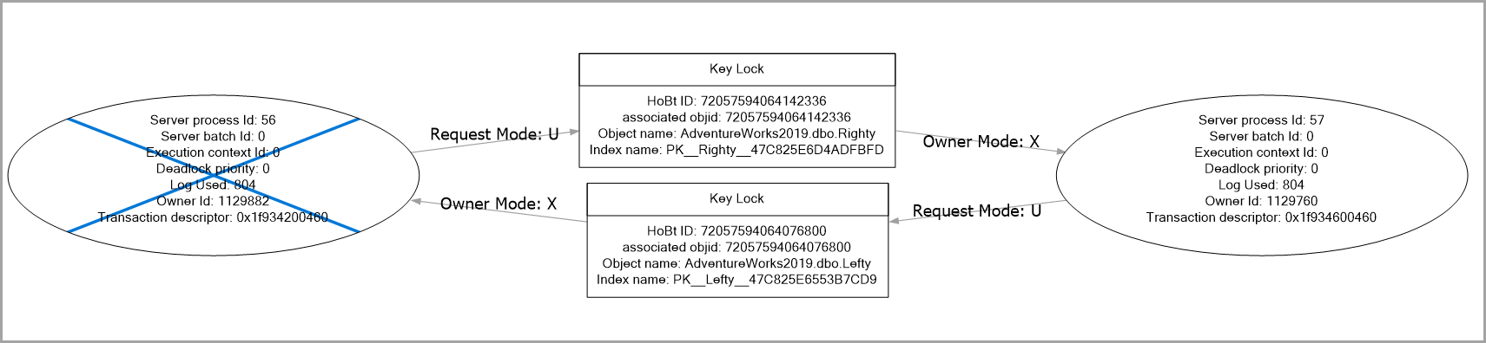
Great for DBAs, but
You’re still stuck with two issues - 2
Presentability
Even in SSMS, some of the data needs extra steps to be in a user-friendly format.
Specifically deadlock graphs.

Slide 9

Bonus
If you work for an ISV, consulting company or are an independent consultant, you might:
Get pushback from customers when it comes to creating 3rd party stored procedures
Have to deal with a lot of back-and-forth to get a clear picture of what’s going on

Slide 10
Tackling the second pain point
If you can’t find it, build it yourself
What I wanted
Challenges
Built on top of the SQL Server First Responder Kit
No setup
Get data in one go
No permanent objects
Output report in Excel and HTML
Links to in-depth explanations
Execution plans and deadlock graphs as files
Complexity: Integrating multiple diagnostic scripts into one cohesive tool
Compatibility: Ensuring the tool works across different SQL Server versions and environments

Slide 11
Tackling the second pain point
Development process
Steps
Overcoming Obstacles
Research existing tools and needs
Prep home lab and test workloads
Coding the PowerShell script and integrating the diagnostic scripts
Rigorous testing
Repeat steps 3 and 4
Modular Design: Made the script modular for easy updates and maintenance
User Feedback: Incorporated feedback from early users to refine features
Custom scripts: to accommodate cloud environments

Slide 12
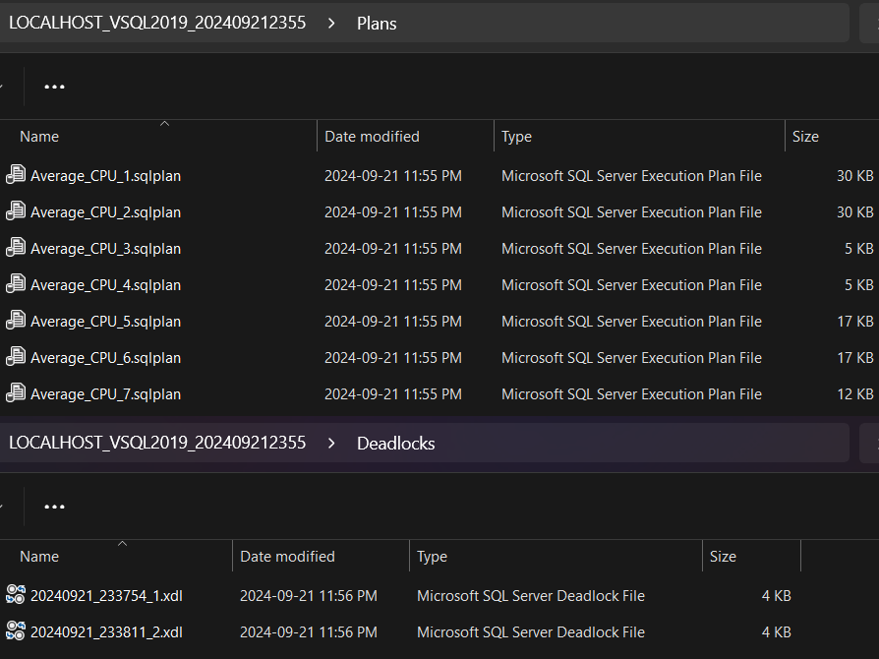
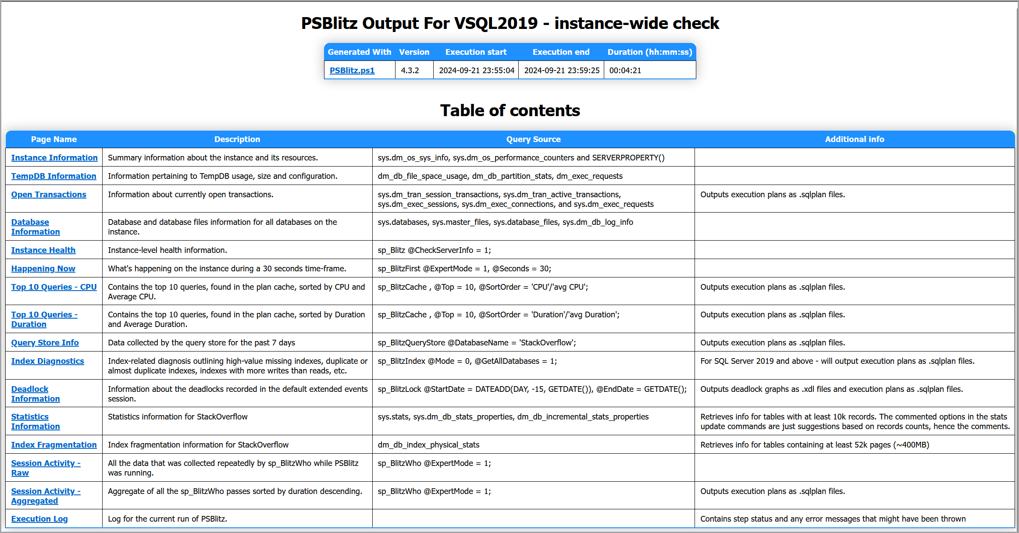
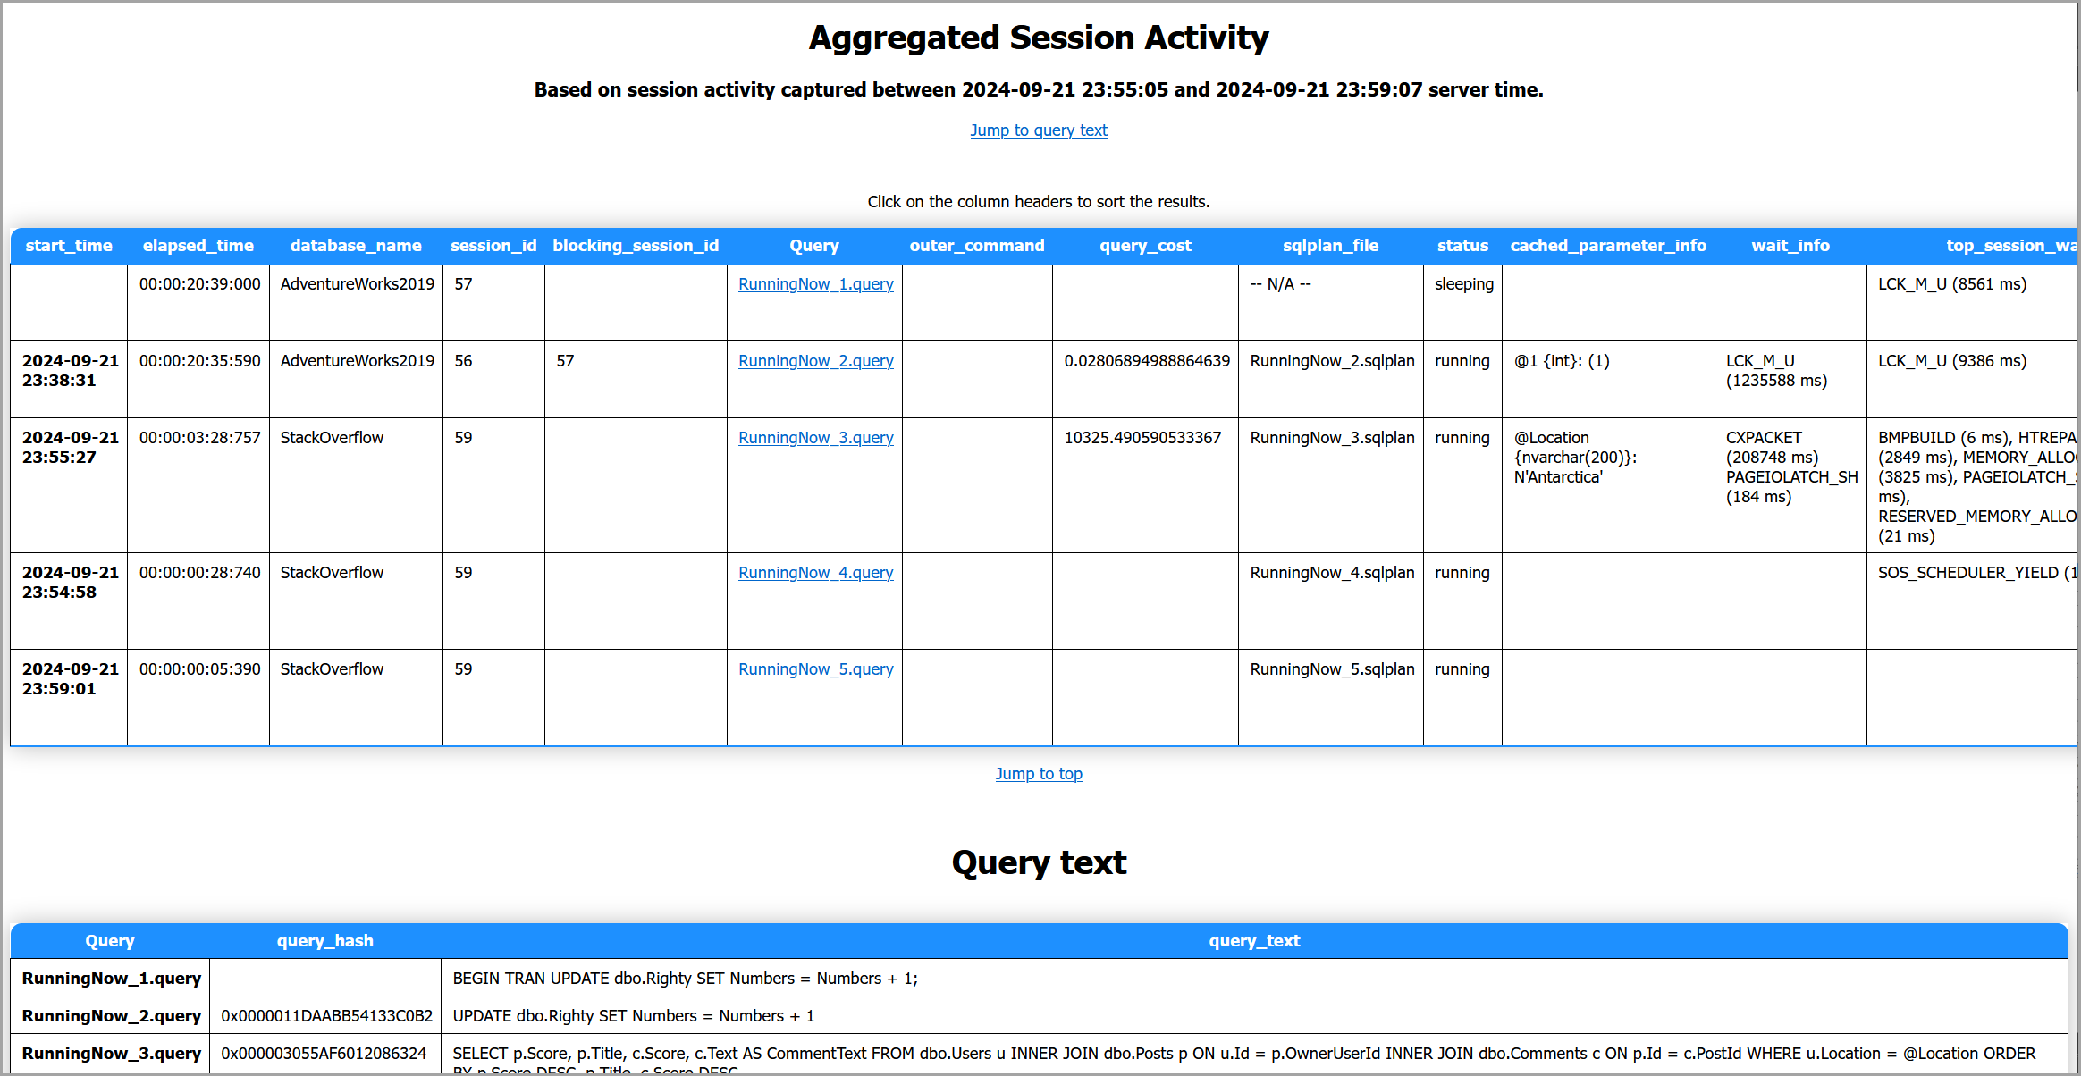
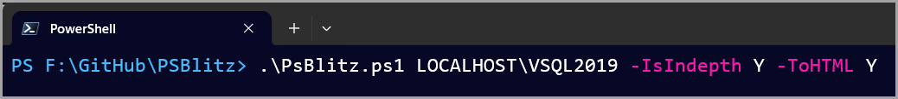

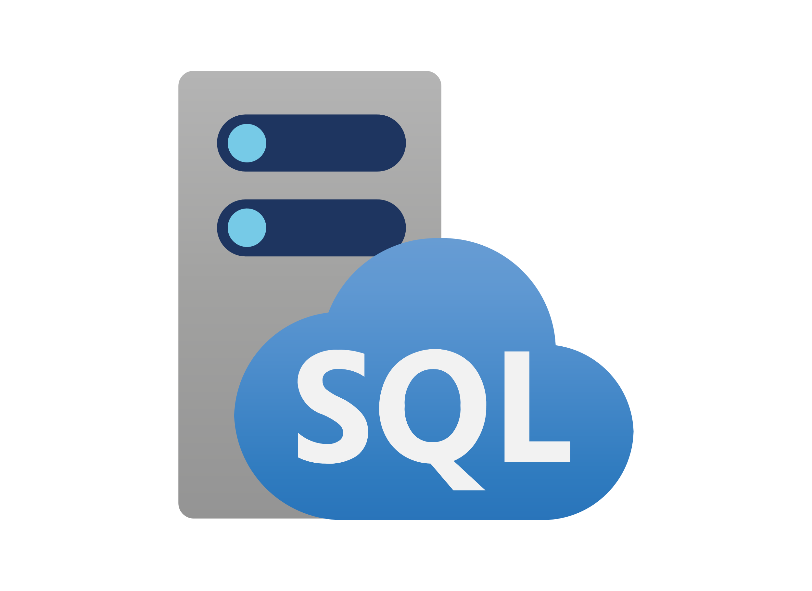
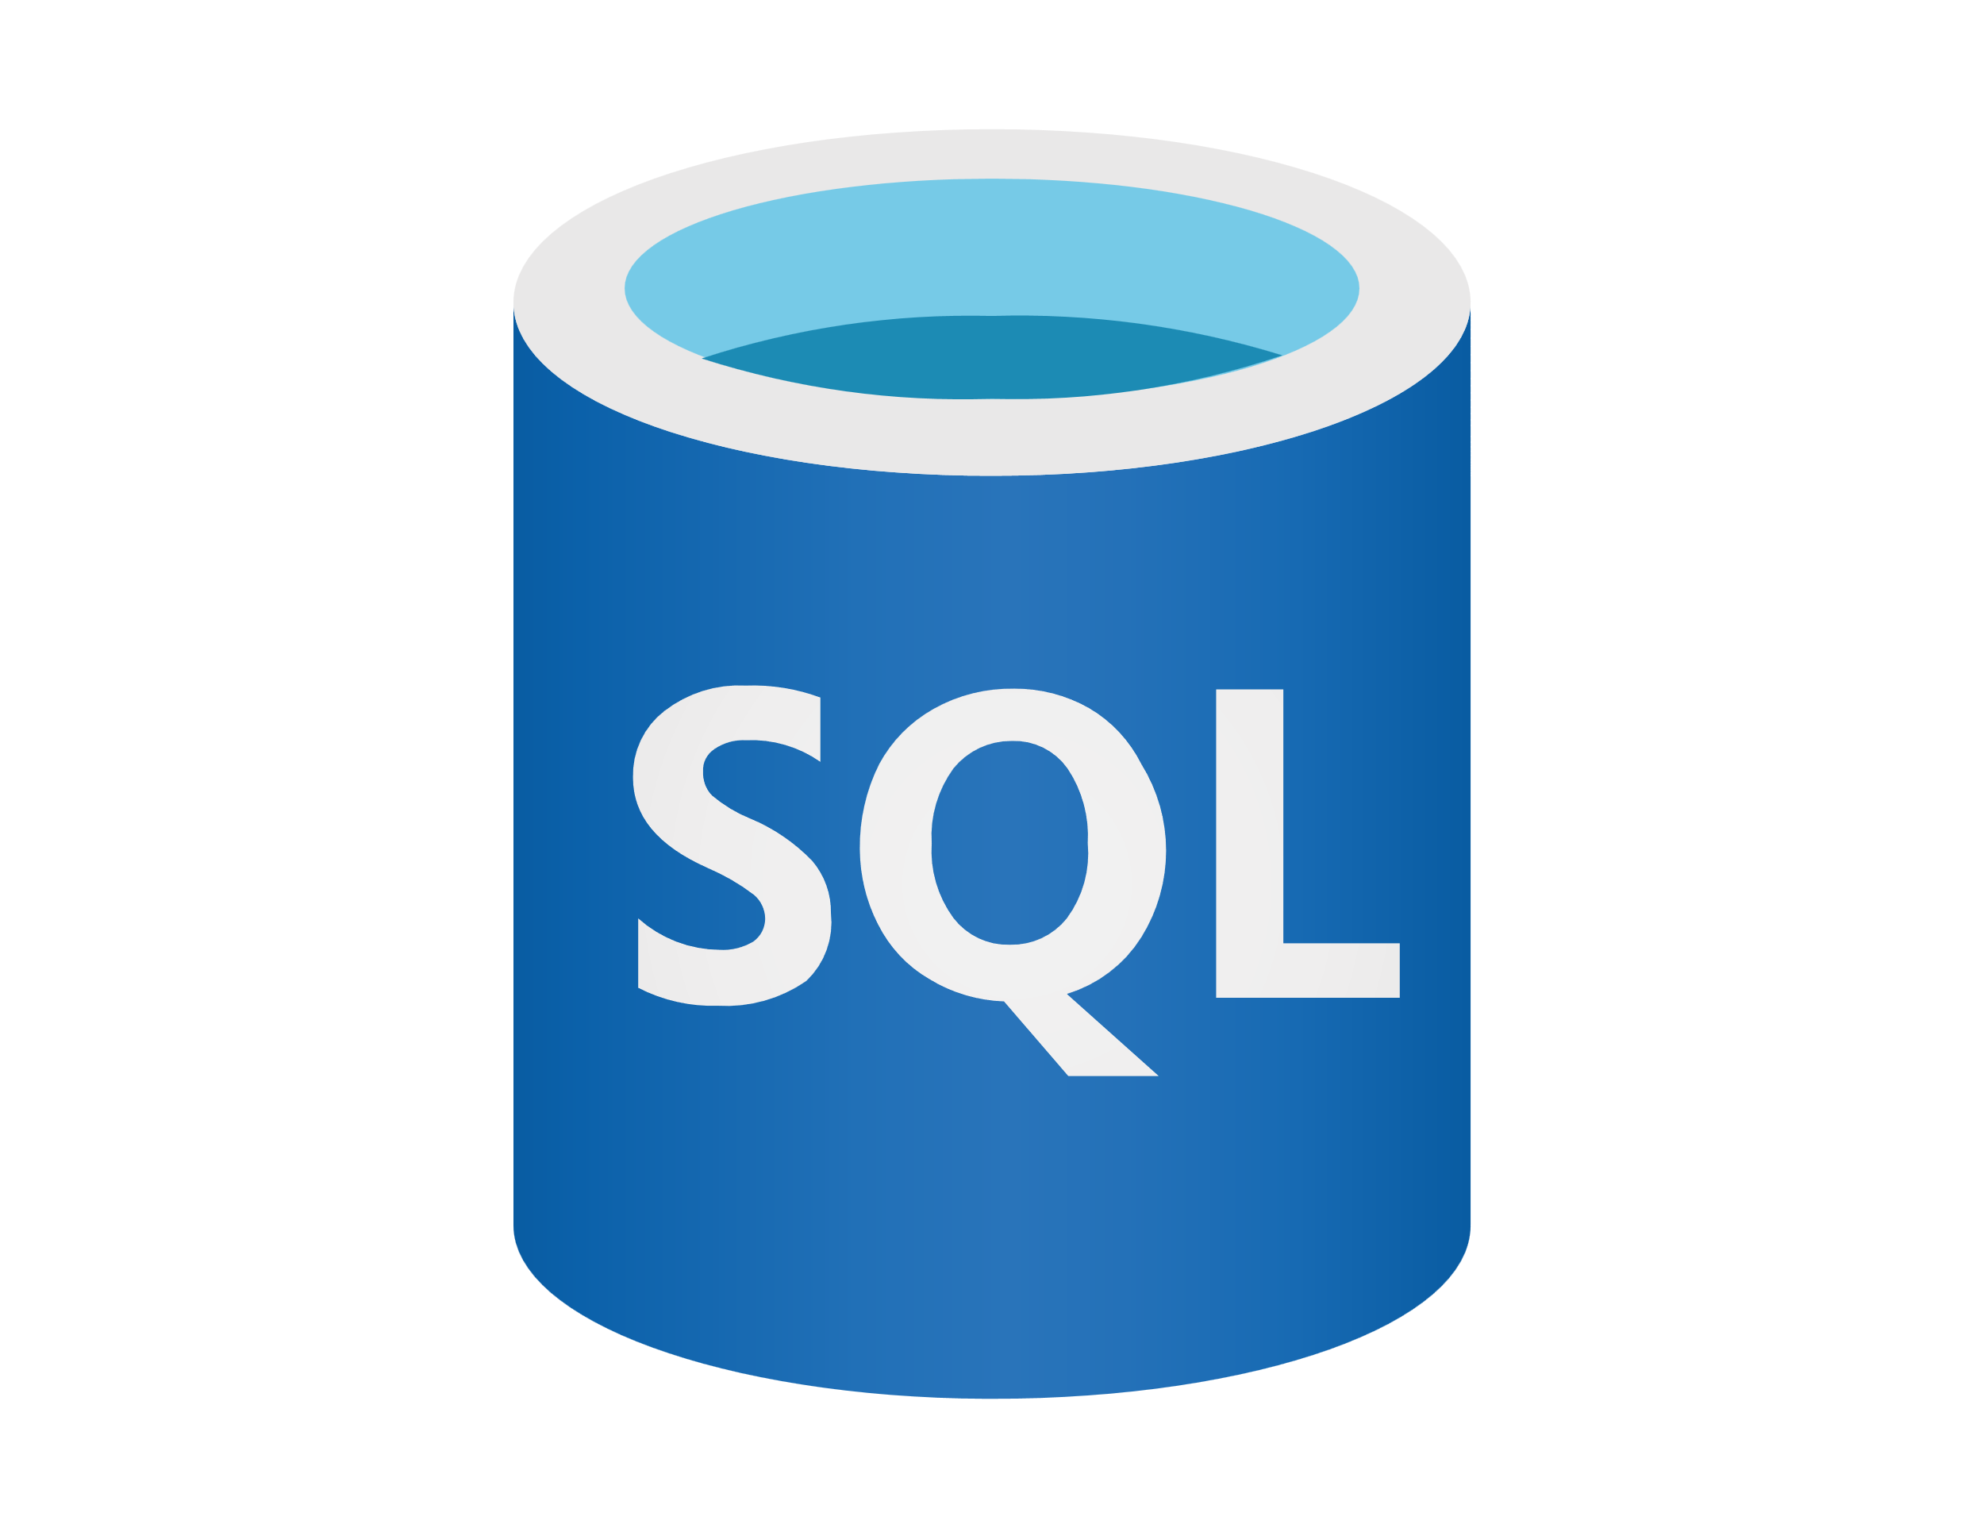
End result
PSBlitz - An all-in-one SQL Server diagnostics tool
Key Features
Simple execution
Comprehensive reports in Excel and HTML
Active session monitoring
Related execution plans and deadlock graphs automatically exported as files
Compatibility with both on-prem and cloud

Slide 13
Unexpected bonus
Impact and adoption
Featured by Brent Ozar as part of the 2022 community tools month
Great feedback and suggestions from community members
It ended up being even more helpful in my current role

Slide 14






The selfish part – take 2
I ended up learning a lot
How it started
How it’s going

Slide 15
Future plans
Next steps
Enhancements: Add more features based on user feedback
Community Involvement: Encourage more contributions and collaborations.

Slide 16
Conclusion
10/10 would recommend
Necessity is the mother of invention
Great learning experience
Ended up helping others while trying to help myself

Slide 17

Q&A
Learn more from Vlad Drumea
/vladdrumea
@VladDBA
/VladDBA
https://vladdba.com

Slide 18



Links
SQL Server First Responder Kit
PSBlitz
StackOverflow Database

